Slide 1
Bridges to schools mke specialist
Notes:
This is the first slide everybody.

Slide 2
4C for Children Vision: “Helping the community navigate resources and supports to enhance early childhood development experiences.”
Notes:
This is the first slide everybody.

Slide 3
Meet Tad kriofske Mainella: Bridges to Schools Specialist
The Goal:
Connect families, communities & children to resources that increase school readiness.
The Truth:
Children are more prepared for school when parents play, share & listen more & we’ve got FREE resources to help!

Slide 4
About me
Eight years as Teacher & Community Support Specialist in MPS
Parent of 2 MPS children
Montessori Certified: I believe children learn best through hands-on experience
M.Ed. in Educational Leadership
Fan of MKE WMSE Radio, Pilcrow Coffee & Your Milwaukee Brewers

Slide 5
Why: VROOM helps parents discover that they already have what it takes to boost their child's learning!
My favorite resource for parents:
vroom

Slide 6
VROOM SAMPLE TIP

Slide 7
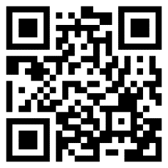
What I learned from the Vroom Tip
Just playing around & asking questions IS preparing your child for school!
Scan QR Code for FREE School-Prep Tips from Vroom:

Slide 8
Looking for MORE INFO about school-readiness skills?
Visit Bridges to Schools Website
https://www.4cfc.org/bridges-to-school/
Or Contact
Tad Kriofske Mainella
Bridges to Schools MKE Specialist
414-659-4438
tmainella@4cfc.org
Notes:
This is the first slide everybody.

Slide 9
THANK YOU
Tad Kriofske Mainella
Bridges to Schools MKE Specialist
414-659-4438
tmainella@4cfc.org
https://www.4cfc.org/bridges-to-school/

