Slide 1
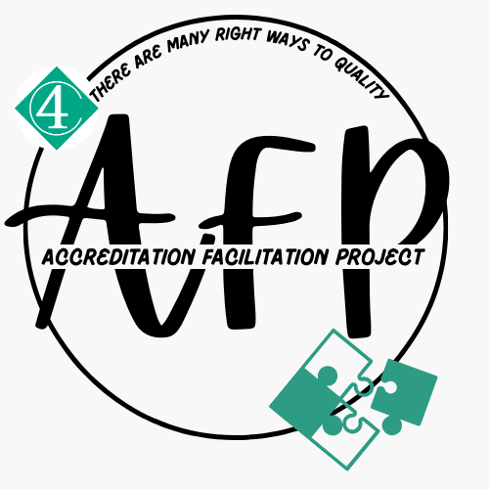



Meet The Accreditation Facilitation Project Funders & Collaborators
The Accreditation Facilitation Project is made possible by the generous funding and support of The Greater Milwaukee Foundation and Milwaukee Succeeds

Slide 2
What is accreditation?
Accreditation is a review process preformed by a nationally recognized outside agency. It involves staff and family participation, and supports programs with quality improvement, self assessment and reflection by utilizing self-studies and program and class observations.
Accreditation organizations that we are in working with:
NAEYC (National Association for the Education of Young Children) Accreditation | NAEYC
NAFCC (National Association for Family Child Care Accreditation - NAFCC

Slide 3
THE ACCREDITATION FACILITATION PROJECT
The role of the Accreditation Facilitation Project is to guide and support programs throughout their accreditation journey by...
Offering Practice Based Coaching and technical assistance, specifically around reviewing & aligning your program with NAEYC or NAFCC Standards.
Providing financial assistance as deemed necessary to cover costs of accreditation fees and associating fees (trainings, materials, etc.) to meet NAEYC or NAFCC Standards.
Providing opportunities for programs to connect with other participating programs, to learn from one another and to build strong long-lasting community relationships.

Slide 4
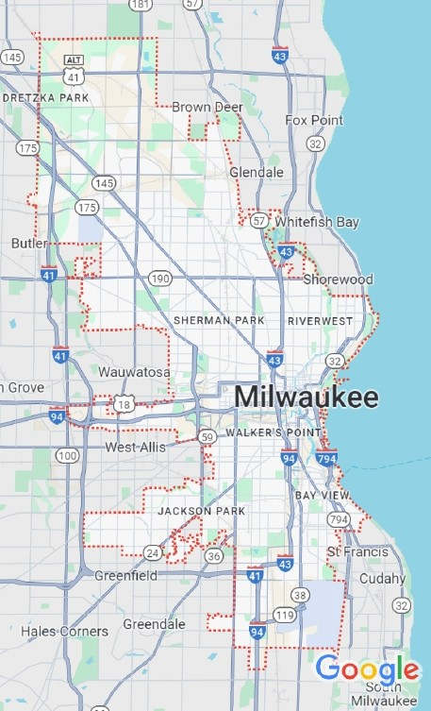
ACCREDITATION FACILITATION PROJECT ELIGIBILITY
Program is located in the City of Milwaukee and has a current license through the Department of Children and Families.
At the time of committing to AFP, the program has a current YoungStar rating of a 2 Star, 3 Star or 4 Star.
Program is committed to providing ongoing quality care to the children, families and community served.

Slide 5
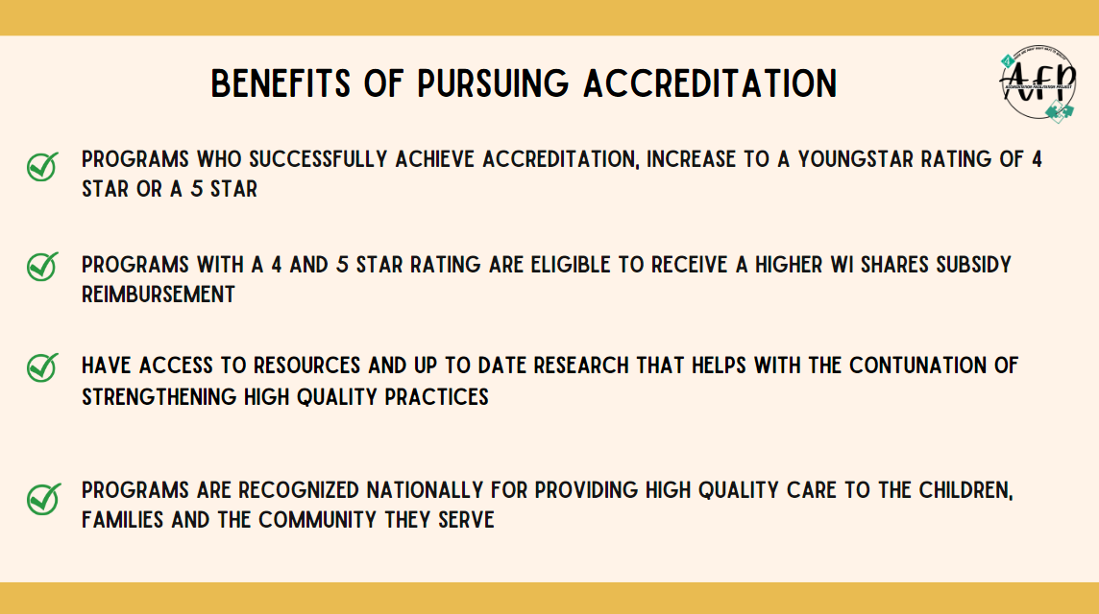

Slide 6
If you’re already familiar with NAEYC or NAFCC and are currently in the accreditation process or interested, please be aware of the following:
Both NAEYC and NAFCC are making adjustment to their portals, standards, and procedures. These changes go into effect in 2025.
NAEYC changes go into effect March 2025. NAFCC changes have already started (portal has been updated and revised standards have been released). The rest of the changes will go into effect January 2025.

Slide 7
Interested?
Please reach out to Sarah Hernandez, shernandez@4cfc.org, 414-519-1583 to learn more about the Accreditation Facilitation Project.
There is currently waitlist, however – please reach out to me for the following:
  To get an introduction to Accreditation
  To learn about additional eligibility for NAEYC And NAFCC accreditation
  To learn more about the NAEYC and NAFCC processes
  To get added to the waitlist

